Slide 2
Energy Management System (ISO 50001) What have we done so far?
We have collected Best Practices from mills with the aim of making ISO 50 001
-as useful as possible
-as painless as possible
By
-collecting / developing templates for e.g. the Energy review
-identifying information that are industry specific e.g. variables affecting the energy performance
-identifying existing internal routines that already support ISO 50 001 e.g. Investment Guidelines, contract templates

Slide 3
Energy Management System (ISO 50001)
Praktisk nytta av nya versionen?
Kravet på normalisering av mätare samt bevis på effektivisering har fått oss att tänka på vad och hur vi skall mäta energi effektivitet…

Slide 4
ISO 50001:2018 Definition of a useful KPI
ISO 50 001 should help organizations to improve their energy performance.
Unfortunately the typical EnPI:s do not fulfill the criteria of a good KPI which are:
Define useful KPI:s
Gives answers
Relevant = can be influenced, big (enough) impact on the bottom line
Timely -> On-Line

Slide 5
SEC factor analysis, Specific Energy Consumption

Slide 6
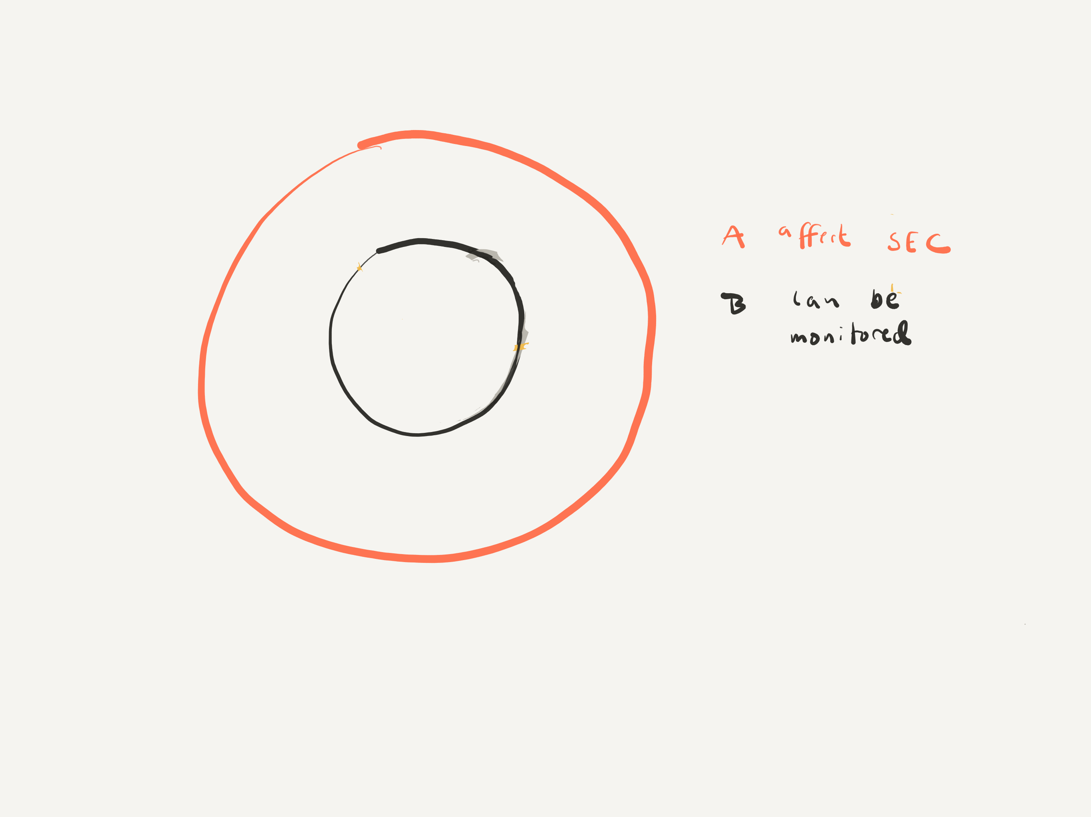
SEC factor analysis, Specific Energy Consumption

Slide 7
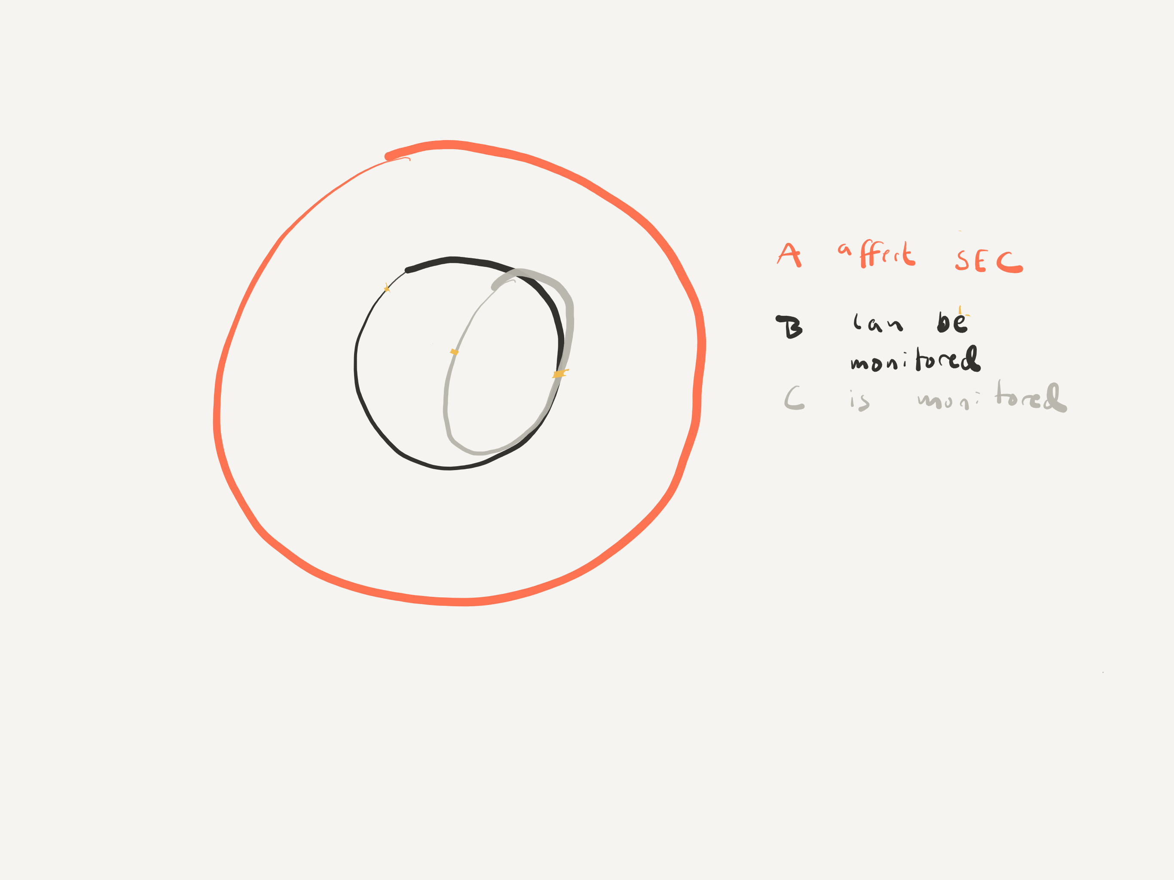
SEC factor analysis, Specific Energy Consumption

Slide 8
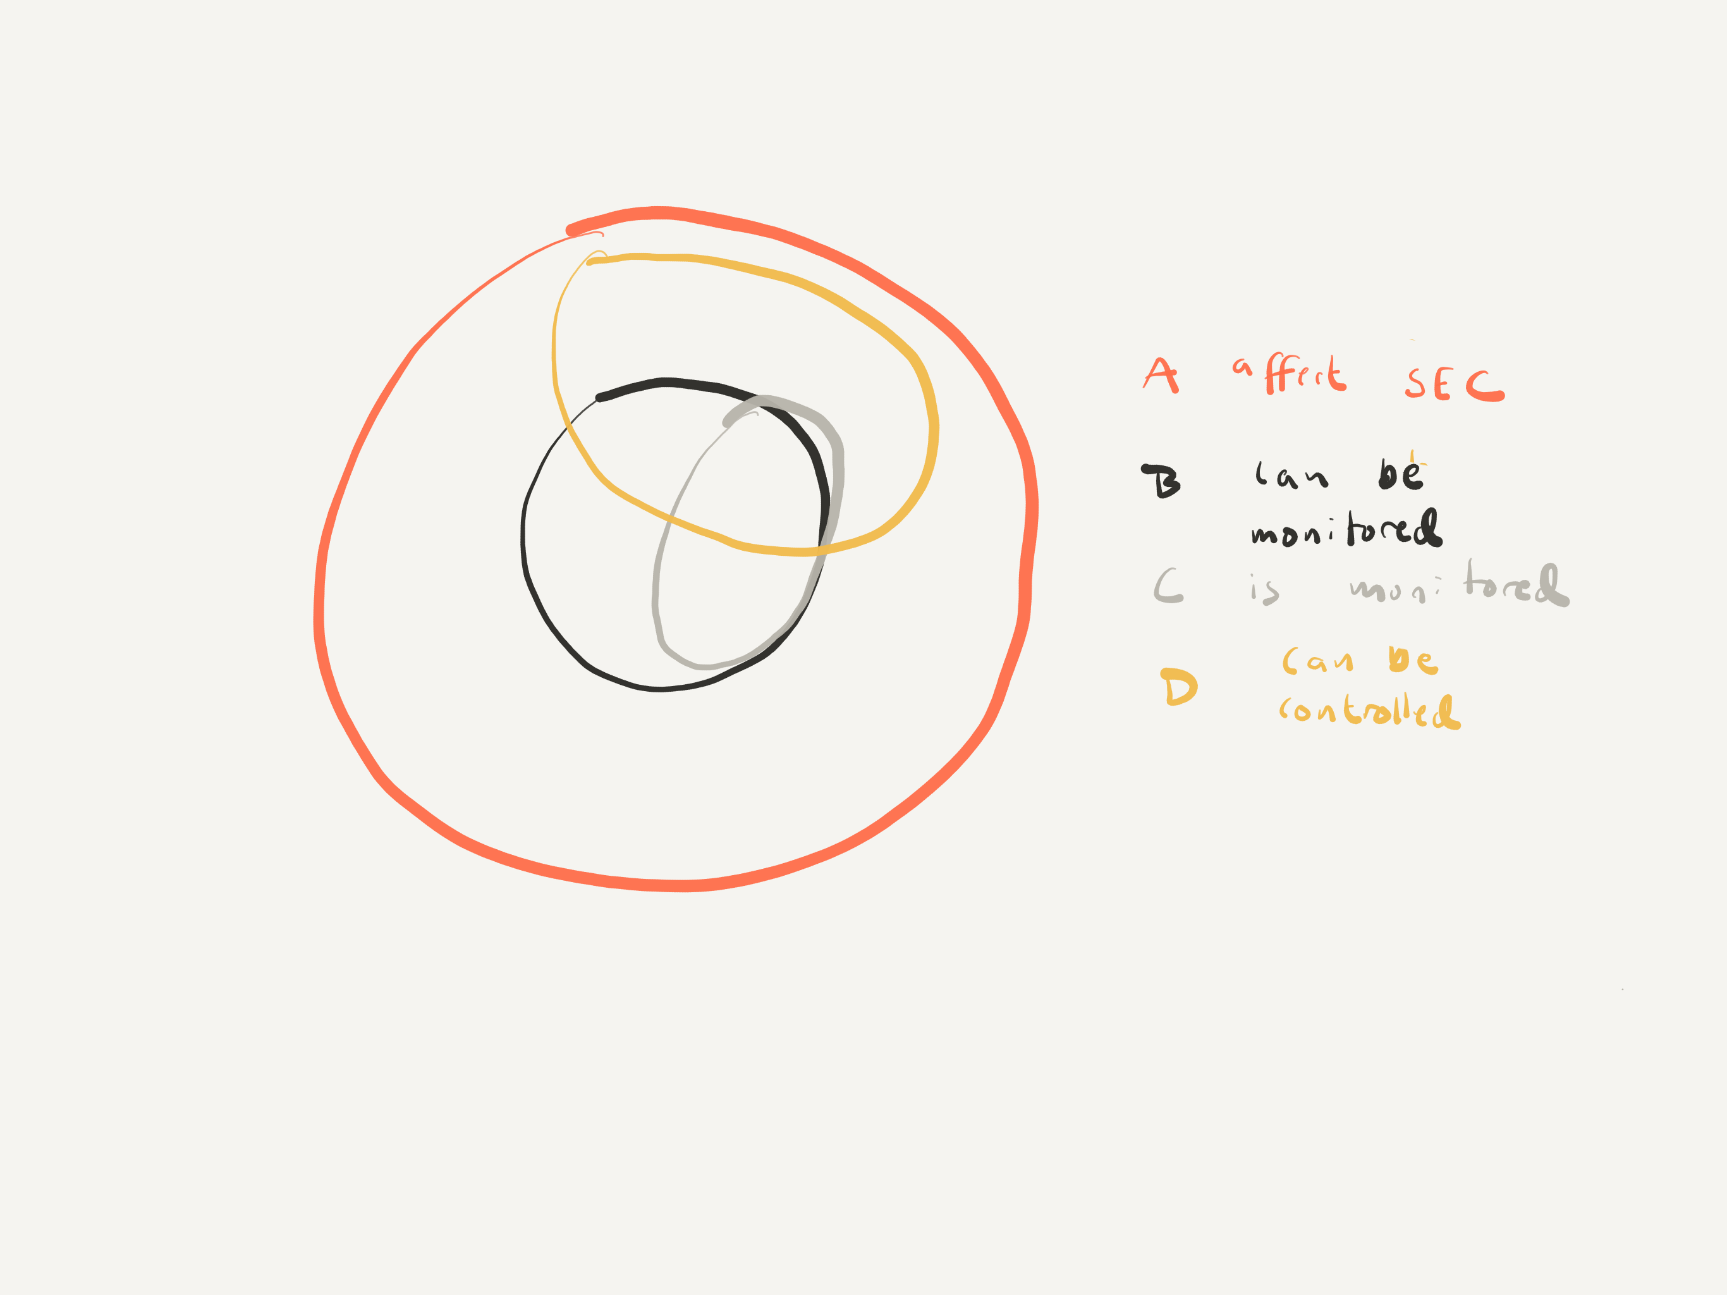
SEC factor analysis, Specific Energy Consumption

Slide 9
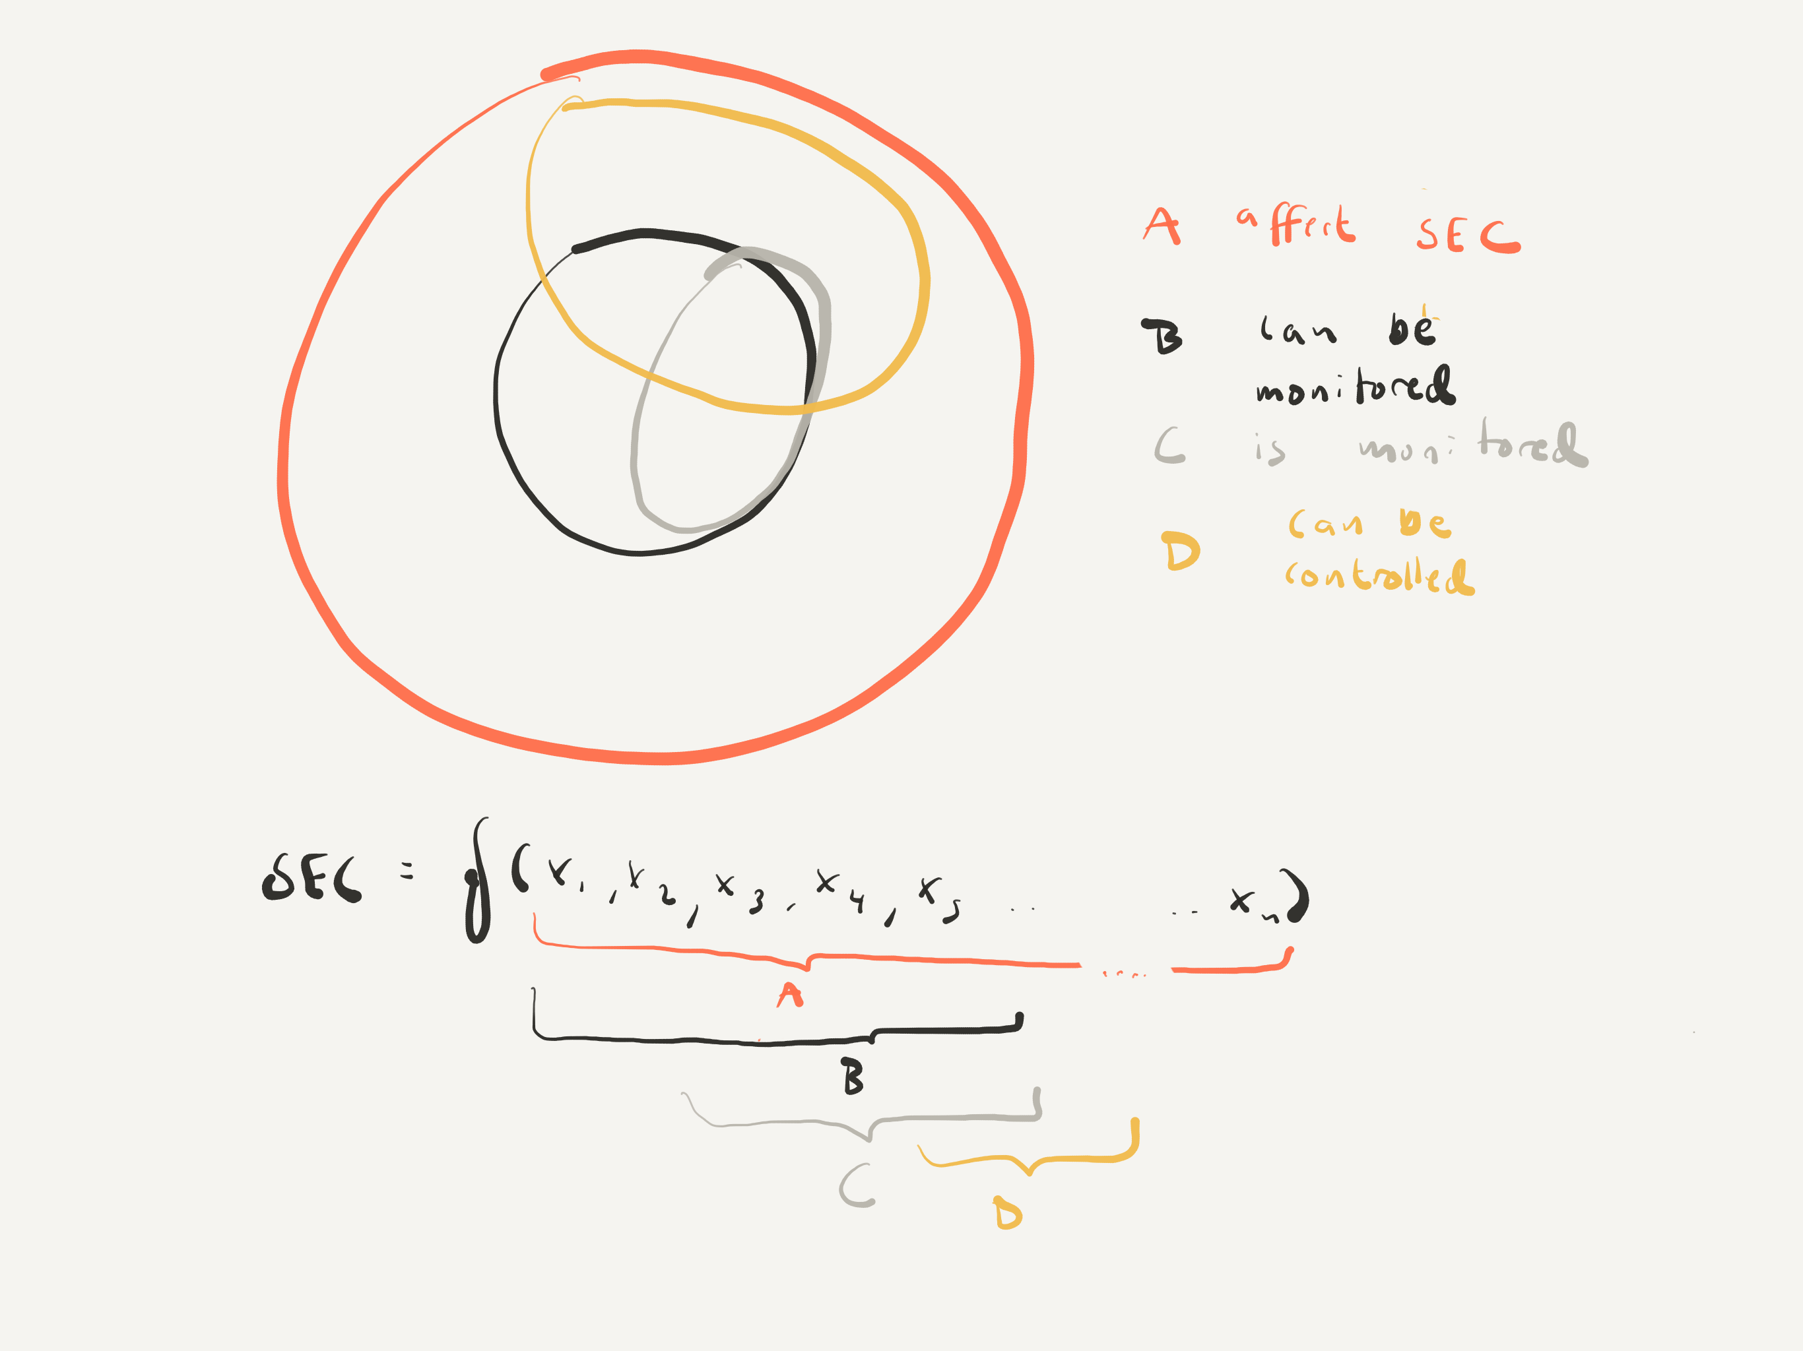
SEC factor analysis, Specific Energy Consumption

Slide 10
SEC factor analysis

Slide 11
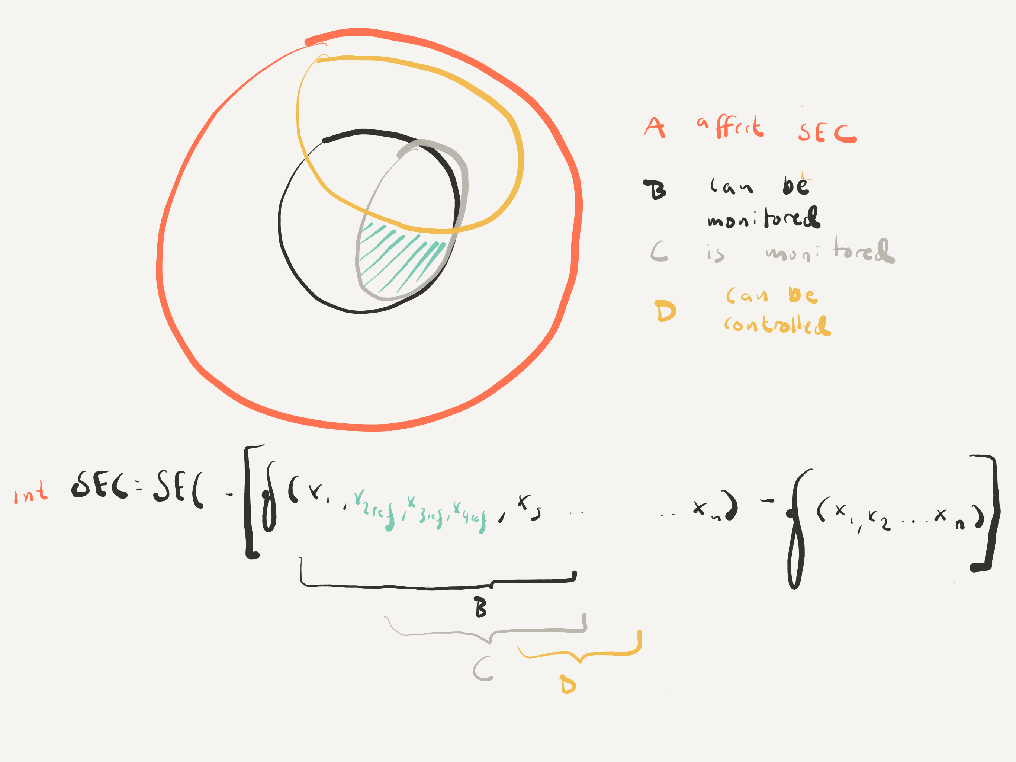
SEC factor analysis, int SEC

Slide 12
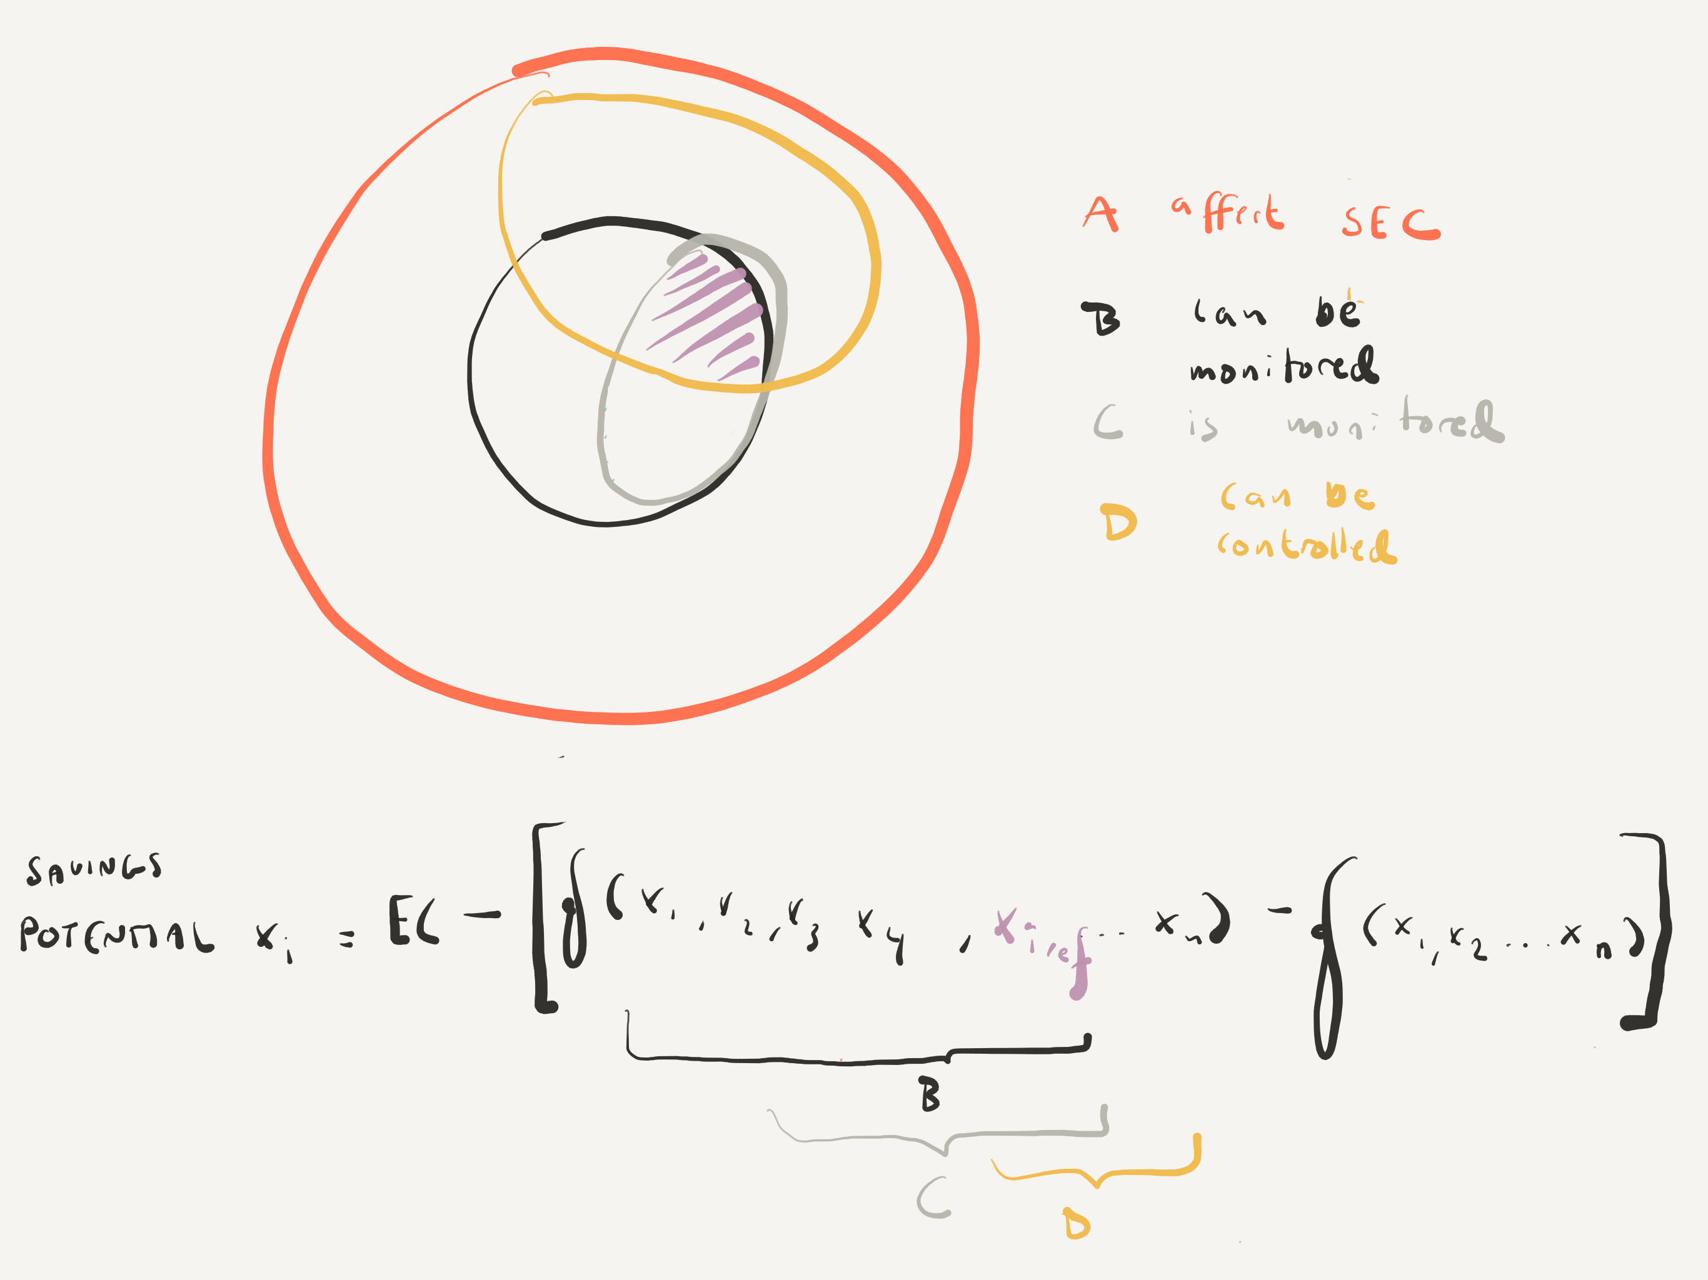
SEC factor analysis, savings potential

